Slide 1
Definition
Environmental studies deals with every issue that affects an organism. It is essentially a multidisciplinary approach that brings about an appreciation of our natural world and human impacts on its integrity. It is an applied science as its seeks practical answers to making human civilization sustainable on the earth’s finite resources. Its components include biology, geology, chemistry, physics, engineering, sociology, health, anthropology, economics, statistics, computers and philosophy.

Slide 2
Scope
As we look around at the area in which we live, we see that our surroundings were originally a natural landscape such as a forest, a river, a mountain, a desert, or a combination of these elements. Most of us live in landscapes that have been heavily modified by human beings, in villages, towns or cities. But even those of us who live in cities get our food supply from surrounding villages and these in turn are dependent on natural landscapes such as forests, grasslands, rivers, seashores, for resources such as water for agriculture, fuel wood, fodder, and fish. Thus our daily lives are linked with our surroundings and inevitably affects them. We use water to drink and for other day-to-day activities. We breathe air, we use resources from which food is made and we depend on the community of living plants and animals which form a web of life, of which we are also a part. Everything around us forms our environment and our lives depend on keeping its vital systems as intact as possible.

Slide 3
Our dependence on nature is so great that we cannot continue to live without protecting the earth’s environmental resources. Thus most traditions refer to our environment as ‘Mother Nature’ and most traditional societies have learned that respecting nature is vital for their livelihoods. This has led to many cultural practices that helped traditional societies protect and preserve their natural resources. Respect for nature and all living creatures is not new to India. All our traditions are based on these values. Emperor Ashoka’s edict proclaimed that all forms of life are important for our well being in Fourth Century BC

Slide 4
Over the past 200 years however, modern societies began to believe that easy answers to the question of producing more resources could be provided by means of technological innovations. For example, though growing more food by using fertilizers and pesticides, developing better strains of domestic animals and crops, irrigating farmland through mega dams and developing industry, led to rapid economic growth, the ill effects of this type of development, led to environmental degradation.
The industrial development and intensive agriculture that provides the goods for our increasingly consumer oriented society uses up large amounts of natural resources such as water, minerals, petroleum products, wood, etc. Nonrenewable resources, such as minerals and oil are those which will be exhausted in the future if we continue to extract these without a thought for subsequent generations. Renew- able resources,

Slide 5
such as timber and water, are those which can be used but can be regenerated by natural processes such as re growth or rainfall. But these too will be depleted if we continue to use them faster than nature can replace them. For example, if the removal of timber and firewood from a forest is faster than the re growth and regeneration of trees, it cannot replenish the supply. And loss of forest cover not only depletes the forest of its resources, such as timber and other non-wood products, but affect our water resources because an intact natural forest acts like a sponge which holds water and releases it slowly. Deforestation leads to floods in the monsoon and dry rivers once the rains are over.
Such multiple effects on the environment resulting from routine human activities must be appreciated by each one of us, if it is to provide us with the resources we need in the long-term. Our natural resources can be compared with money in a bank. If we use it rapidly, the capital will be reduced to zero. On the other hand, if we use only the interest, it can sustain us over the longer term. This is called sustainable utilisation or development

Slide 6
Importance
Environment is not a single subject. It is an integration of several subjects that include both Science and Social Studies. To understand all the different aspects of our environment we need to understand biology, chemistry, physics, geography, resource management, economics and population issues. Thus the scope of environmental studies is extremely wide and covers some aspects of nearly every major discipline.
We live in a world in which natural resources are limited. Water, air, soil, minerals, oil, the products we get from forests, grasslands, oceans and from agriculture and livestock, are all a part of our life support systems. Without them, life itself would be impossible. As we keep increasing in numbers and the quantity of resources

Slide 7
each of us uses also increases, the earth’s resource base must inevitably shrink. The earth cannot be expected to sustain this expanding level of utilization of resources. Added to this is misuse of resources. We waste or pollute large amounts of nature’s clean water; we create more and more material like plastic that we discard after a single use; and we waste colossal amounts of food, which is discarded as garbage. Manufacturing processes create solid waste byproducts that are discarded, as well as chemicals that flow out as liquid waste and pollute water, and gases that pollute the air. Increasing amounts of waste cannot be managed by natural processes. These accumulate in our environment, leading to a variety of diseases and other adverse environmental impacts now seriously affecting all our lives. Air pollution leads to respiratory diseases, water pollution to gastro-intestinal diseases, and many pollutants are known to cause cancer.

Slide 8
Improving this situation will only happen if each of us begins to take actions in our daily lives that will help preserve our environmental resources. We cannot expect Governments alone to manage the safeguarding of the environment, nor can we expect other people to prevent environmental damage. We need to do it ourselves. It is a responsibility that each of us must take on as ones own.

Slide 9
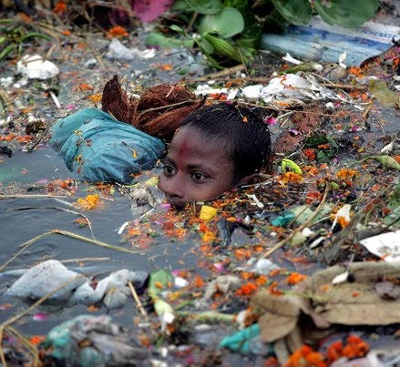

Slide 10
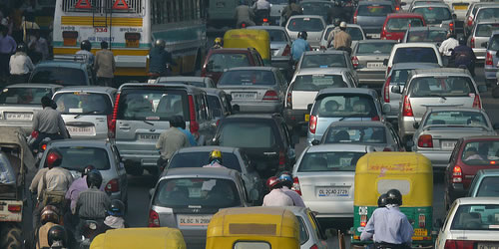

Slide 11
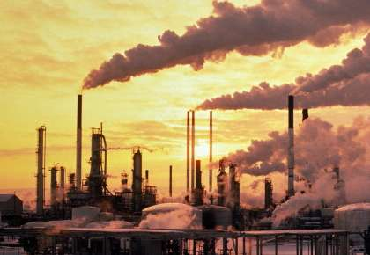

Slide 12
