Slide 1
Dialog Boxes and Menus

Slide 2
Menus
Menu Bar
  Contains menus which drop down to display list of menu items
    Each item has a name and text property
    Each item has a click event
Add MainMenu control to form
  Appears in the Component Tray, below form, where nondisplay controls are shown
  Words "Type Here" appear at the top of the form

Slide 3
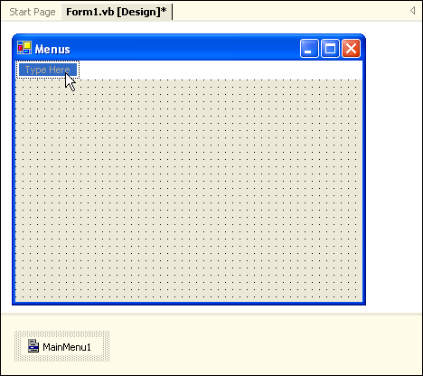
Type first Menu here
MainMenu Control appears in Component Tray

Slide 4
Menu Items
To create the menus simply type where the words "Type Here" appear at the top of the form
Include & symbol as you type to indicate keyboard access keys
You are actually entering the Text property for a MenuItem object
Change MenuItem object names in the Properties window and follow consistent naming conventions

Slide 5
The menu items that you create may contain images, access keys, shortcut keys and check marks as well as text labels
Image
Access Keys
Shortcut Keys
Check Mark

Slide 6
Submenus
Pop up to the right of a menu item
Filled triangle to the right of the menu item indicates to the user the existence of a submenu
Create submenus by moving to the right of a menu item and typing the next item's text

Slide 7
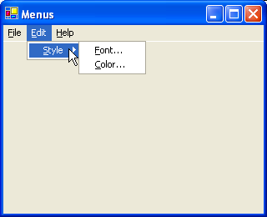
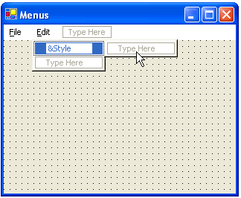

Slide 8
Context Menus
Shortcut menus that pop up when you right-click
Are specific to the component to which user is pointing, reflecting options available for that component or situation
A context menu does not have a top level menu
Application can have multiple context menus

Slide 9
Add ContextMenu component to the form
  Appears in the Component Tray
Click on the words "Context Menu", at the top of the form, the words "Type Here" appear
Click on the words "Type Here" and proceed as you did for the main menu

Slide 10
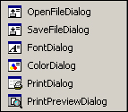
The Built –in Dialog Boxes
OpenFileDialog
SaveFileDialog
FontDialog
ColorDialog
PrintDialog

Slide 11
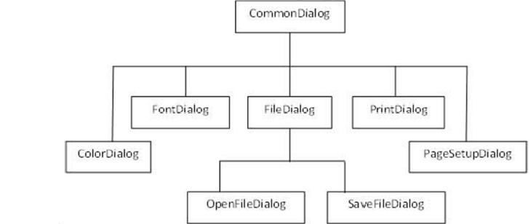

Slide 12
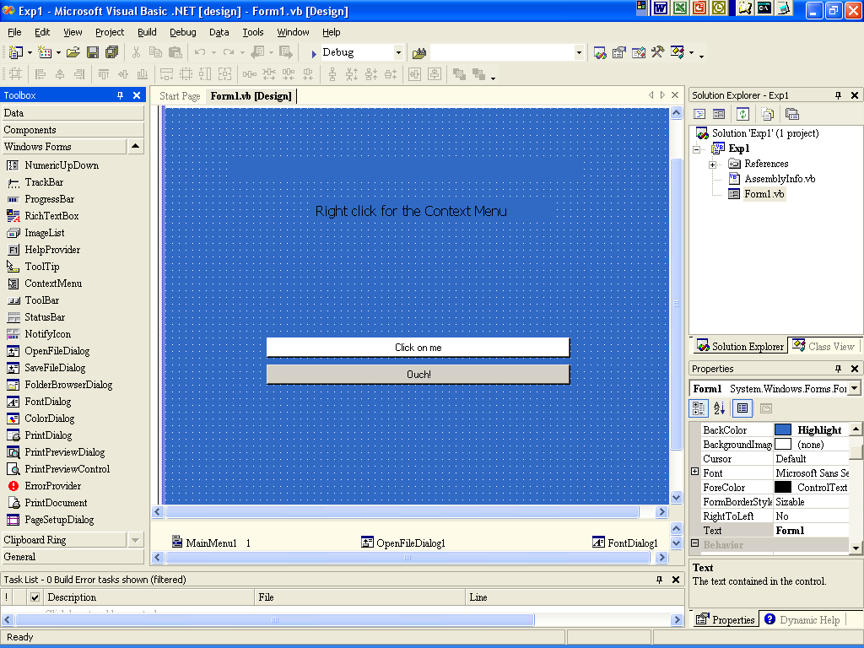
Common dialog controls
Component tray

Slide 13
Displaying a Windows Common Dialog Box
Use ShowDialog method to display the common dialog box at run time
ShowDialog only displays the dialog, it does not do anything else
ColorDialog1.ShowDialog( )
FontDialog1.ShowDialog( )

Slide 14
OpenFileDialog
The Open file dialog control prompts the user to open a file and allows the user to select a file to open
The user can check if the file exists and then open it
It inherits from the abstract class FileDialog

Slide 15
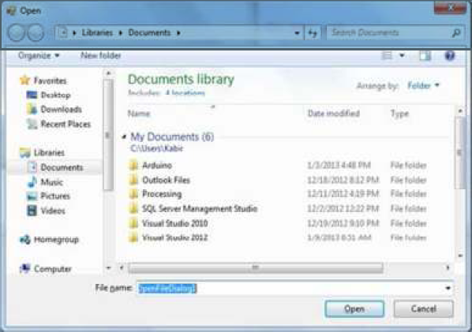

Slide 16
Properties
Properties Means
AddExtension Gets/Sets if the dialog box adds an extension to file names if
the user doesn’t supply the extension.
CheckFileExists Gets/Sets if the dialog box displays a warning if the user specifies a nonexistent file.
CheckPathExists Gets/Sets whether the dialog box displays a warning if the user gives a path that does not exist.
DefaultExt Gets/Sets the default file extension.
FileName Gets/Sets the file name selected in the file dialog box.
FileNames Gets the file names of all selected files.
Filter Gets/Sets the current file name filter string, which sets the choices that appear in the “Save As File type” or “Files of type” box.
InitialDirectory Gets/Sets the initial directory used in the file dialog box.

Slide 17
Methods
Method Means
OpenFile Opens the file selected by the user, with read only permission. The file is specified by the FileName property.
Reset Resets all options to their default values.
ShowDialog Show the dialog box.

Slide 18
Events
Method Means
FileOk Occurs when the user clicks the Open or Save Button.
HelpRequest Occurs when the user clicks the Help Button.

Slide 19
SaveFileDialog
The SaveFileDialog control prompts the user to select a location for saving a file and allows the user to specify the name of the file to save data.
The SaveFileDialog control class inherits from the abstract class FileDialog

Slide 20
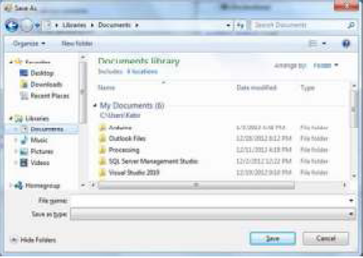

Slide 21
Properties
Properties Means
AddExtension Gets/Sets whether the dialog will add an extension to file name if the user does’nt supply the extension.
CheckFileExists Gets/Sets if the dialog box displays a warning if the user specifies a nonexistent file.
CheckPathExists Gets/Sets whether the dialog box displays a warning if the user gives a path that does not exist.
CreatePrompt Gets/Sets whether the dialog box asks the user if it should create a file if the user specifies a path that does not exists.
DefaultExt Gets/Sets the default file extension.
FileName Gets/Sets the file name selected in the file dialog box.
FileNames Gets the file names of all selected files.
Filter Gets/Sets the current file name filter string, which sets the choices that appear in the “Save As File type” or “Files of type” box.
InitialDirectory Gets/Sets the initial directory used in the file dialog box.

Slide 22
Methods
Method Means
OpenFile Opens the file with read/write permission selected by the user.
Reset Resets all dialog options to their default values.
ShowDialog Show the dialog.

Slide 23
Events
Method Means
FileOk Occurs when the user clicks the Open or Save Button.
HelpRequest Occurs when the user clicks the Help Button.

Slide 24
FontDialog
It prompts a user to choose a font from among those installed on the local computer and lets the user select the font, font size and color.
It returns the font and color objects
By default the Color ComboBox is not shown on the Font Dialog box. You should set the ShowColor property of the FontDialog control to be true.

Slide 25
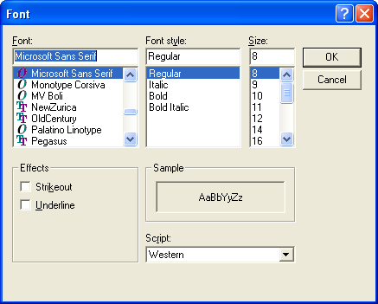

Slide 26
Properties
Properties Means
AllowSimulations Gets/Sets whether the dialog box allows graphics device interface font simulations.
Color Gets/Sets the selected font color.
Font Gets/Sets the selected font.
MaxSize Gets/Sets the maximum point size a user can select.
MinSize Gets/Sets the minimum point size a user can select.
ShowColor Gets/Sets whether the dialog box displays the color choice.
ShowApply Gets/Sets whether the dialog box contains an apply button.
ShowEffects Gets/Sets whether the dialog box contains controls that allow the user to specify strikethrough, underline and text color options.

Slide 27
Methods
Method Means
Reset Resets all dialog options to their default values.
ShowDialog Show the dialog.

Slide 28
Events
Method Means
Apply Occurs when the user clicks the Apply Button.
HelpRequest Occurs when the user clicks the Help Button.

Slide 29
ColorDialog
The color dialog control class represents a common dialog box that displays available colors along with controls that enable a user to define custom colors.
It lets a user select a color
The main property of the ColorDialog control is Color, which returns a color object

Slide 30
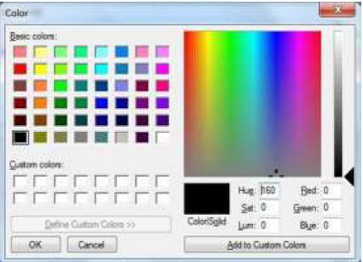

Slide 31
Properties
Properties Means
AllowFullOpen Gets/Sets whether the user can use the dialog box to define custom colors.
AnyColor Gets/Sets whether the dialog box displays all available colors in the set of basic colors.
Color Gets/Sets the color selected by the user.
CustomColors Gets/Sets the set of custom colors shown in the dialog box.
ShowHelp Gets/Sets whether the help button appears in the color dialog box.

Slide 32
Methods
Method Means
Reset Resets all dialog options to their default values.
ShowDialog Show the dialog.

Slide 33
Events
Method Means
HelpRequest Occurs when the user clicks the Help Button

Slide 34
PrintDialog
It lets the user to print documents by selecting a printer and choosing which sections of the document to print from a Windows Form Application.
There are various other controls related to printing of documents.
PrintDocument
PrinterSettings
PageSetUpDialog
PrintPreviewControl
PrintPreviewDialog

Slide 35
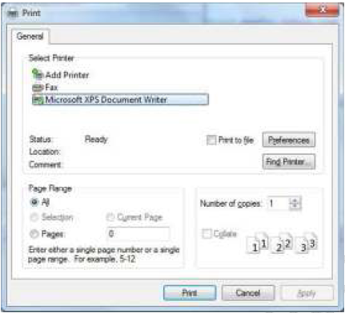

Slide 36
Properties
Properties Means
AllowPrintToFile Gets/Sets whether the print to file checkbox is enabled.
AllowSelection Gets/Sets whether the selection radio button is enabled.
AllowSomePages Gets/Sets whether the From..To.. Page radio button is enabled.
Document Gets/Sets the PrintDocument used to obtain PrinterSettings.
PrinterSettings Gets/Sets the PrinterSettings Dialog box to modify.
PrintToFile Gets/Sets whether the print to file checkbox is enabled.
ShowHelp Gets/Sets whether the help button is displayed.

Slide 37
Methods
Method Means
Reset Resets all dialog options to their default values.
ShowDialog Show the dialog.

Slide 38
Events
Method Means
HelpRequest Occurs when the user clicks the Help Button

