Slide 1
.Net Technology

Slide 2
History of .Net
Introduced by Microsoft
Earlier technology was VC++ and VB
VC++ comes with so many library and VB was so easy to use and not flexible to develop a serious application
Good competition from Sun’s java and j2ee
.Net resolved all this problem

Slide 3
.Net Application
Window based application
Web based application
Console Application
Web Services
  In Web Services, software functionality becomes exposed as a service

Slide 4
Framework, Languages, And Tools
VB
VC++
VC#
JScript
…
Visual Studio.NET
Common Language Specification
ASP.NET: Web Services
and Web Forms
Windows
Forms
ADO.NET: Data and XML
Base Class Library
Common Language Runtime

Slide 5
.Net Framework
A component that provides facility to build and run an application
Intermediate layer between
OS and Programming Language
Not an OS, Not a Language
Supports many programming languages, including VB.NET, C# etc
.NET Application
.NET Framework
Operating System + Hardware

Slide 6
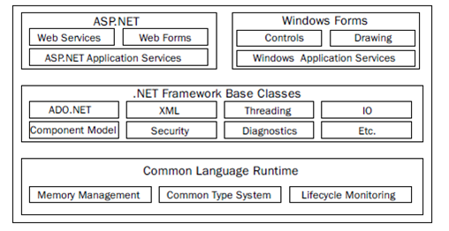
.Net Framework Cont…
Two main part of .Net Framework
  Common Language Runtime
  Base class library

Slide 7
Common Language Runtime (CLR)
Runtime execution environment
Manage and execute code written in any .net language
Runtime is an agent that manages code at execution time , providing core services such as memory management, thread management while also enforcing strict type safety and other forms of code accuracy.

Slide 8
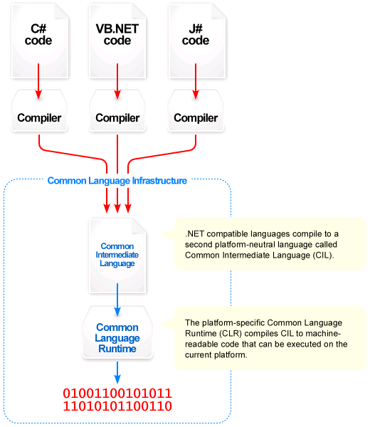
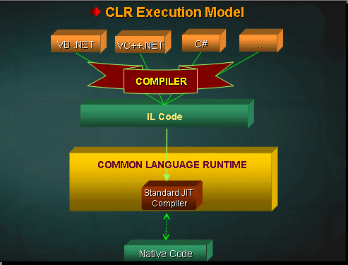
CLR Execution Model

Slide 9
MSIL or IL (Platform Independence)
Microsoft intermediate language(MSIL) or Intermediate language(IL) is independent of programming language, targeting machine and OS
Process of Traditional compiler
  Source code Machine code
  Platform dependent
Compiler targeting .Net
  Source code MSIL Machine Code
  Platform independent
Compiled
Compiled
Execute

Slide 10
MSIL or IL (Platform Independence)
The MSIL code includes the instructions to load, initialize and invoke methods on Objects
It also includes the instructions for various operations on programs code such as arithmetic and logical operations, control flow, exception handling

Slide 11
Comparison to Java
Hello.java
Hello.class
JVM
compile
execute
Source code
Byte code
Hello.vb
Hello.exe
CLR
compile
execute
Source code
CIL

Slide 12
Base Class Library(BCL)
Also referred as Framework Class Library(FCL)
It is library of classes available to all languages using .NET
framework
It provides classes, which encapsulate a no. of common function, including file reading & writing, graphic rendering, DB interaction & XML document manipulation.

Slide 13
ADO.NET
It is a set of computer software components
It is use to access data and data services
It is a part of BCL
Consists of 2 parts :-
  Data Provider – Connection, Parameter, Data Adapter, Data Reader
  Dataset

Slide 14
Web Services
Web Services provide data and services to other applications.
Web services are small units of code
Benefits of Web Services
Easier to communicate between applications
Easier to reuse existing services
Easier to distribute information to more consumers
Rapid development

Slide 15
Common Language Specification (CLS)
  CLS is the collection of the rules and constraints that every language (that seeks to achieve .NET compatibility) must follow.
  CLS is nothing but guidelines that language to follow so that it can communicate with other .NET languages in a seamless manner
  It is a subset of the CTS

Slide 16
Common Language Specification (CLS)
Microsoft defined 3 levels of CLS :-
  Compliant Provider
  Consumer
  Extender

Slide 17
CLR
Important component of .Net Framework
Supervise the execution of a .Net Program by providing various properties and controls in the areas of memory management, security, exception handling
The CLR manages the execution of the code therefore the code that works on the CLR is called the managed code.

Slide 18
Architecture of CLR
Base Class Library Support
Thread Support
Type Checker |  | Exception Manager
Security |  | Debug Engine
JIT Compiler | Code Manager |  | Garbage Collector
Class Loader

Slide 19
Architecture of CLR Cont…
Class loader: Manage and loading layout of class
JIT compiler: Converts MSIL to native code
Code manager: Manages code execution
Garbage Collector: Handle automatic Memory management
Security engine: It provides security based on policies and permissions that allow execution of mistrusted code to run in secure environment so they do not cause any problems. It will grant full access to trusted code.

Slide 20
Architecture of CLR Cont…
Debug Engine: Allow to debug an application and trace the execution of code
Type Checker: Type checker will verify types used in the application with CTS or CLS standards supported by CLR
Exception Manager: Handles Errors at runtime using try.. catch..finally blocks.
Thread Support: Enable multi-threaded programming

Slide 21
Architecture of CLR Cont…
The CLR is composed of 5 primary parts:
  Common Type System(CTS)
  Common Language Specification(CLS)
  Common Intermediate Language(CIL)
  Just-In-Time Compiler(JIT)
  Virtual Execution System(VES)

Slide 22
Common Type System(CTS)
The Common Type System (CTS) is a standard that
specifies how Type definitions and specific values of
Types are represented in computer memory. It is
intended to allow programs written in different
programming languages to easily share information
For example, an integer variable in C# is written as int,
whereas in Visual Basic it is written as integer.
Therefore in .Net Framework you have single class
called System.Int32 to interpret these variables

Slide 23
It defines how to declare, use and manage type in CLR and support cross language integration (code written in one language can interact with the code written in another language that provides Language independence)
Types classified into two categories
  Value Type
  Reference Type

Slide 24
Common Intermediate Language(CIL)
CIL is a CPU- and platform- independent instruction set
It is low-level(machine) language, like Assembler, but is object-oriented
CIL code is verified for safety during runtime
Provides better security and reliability
When the code is executed, the platform-specific VES will compile the CIL to the machine language according to the specific hardware
CIL is passed through the Common Language Runtime’s JIT compiler to generate native code
The native code is executed by the computer’s processor

Slide 25
Just-In Time(JIT) Compiler
Convert the IL into machine code
JIT compilation provides runtime type-safety & assembly verification
To accomplish this, the JIT compiler examines the assembly metadata
Offers better performance than interpreters as the compiled code is stored in memory cache at runtime
Subsequent recompilation or reinterpretation of compiled code can be skipped
Also giving flexibility to automatically recompile & optimize code that is found at runtime to be frequently executed

Slide 26
Virtual Execution System(VES)
The VES provides an environment for executing managed code
It provides the support required to execute the Common Intermediate Language Instruction Set

Slide 27
Managed Code
Code running under control of CLR means code that is executed by CLR
Represents programming code in the low level language MSIL
The binary code is stored in a portable executable (PE) file
It is created during compilation of the Program
It contains definition of each type, signatures of data members in code, detail information about members in a code
Allows integration between components and data types of different programming languages.

Slide 28
Managed Code
Managed code is computer program code that executes under the management of a virtual machine, unlike unmanaged code, which is executed directly by the computer's CPU.
The benefits of managed code include programmer convenience and enhanced security guarantees.
Managed code is designed to be more reliable and robust than unmanaged code , examples are Garbage Collection , Type Safety etc

Slide 29
Benefits of .Net Framework
Consistent Programming Model
  Provides Object Oriented programming model to create programs for performing different tasks
Cross-Platform Support
  Any Windows platform that supports CLR can execute .Net Application
Language Interoperability
  Enables code written in different languages to interact with each other

Slide 30
Benefits of .Net Framework
Automatic Management of resources
  Do not need to manually free the application resources, such as files, memory, network and Database connection
Ease of Deployment

